Slide 1

INFO-6150 Final Project
Professor: Vishal Chawla
Kan Zhang 001529338
Jialin Wang 001561878
Jiaqi Sun 001535397
Xing Dong 001718652
Jingyi Li 001567135
Zhiyao Hou 001029410

Slide 2
Background
Features
Tech Stacks
Presentation

Slide 3
Background
As the final project of INFO-6150, we developed a movie website, functional for movies streaming, reviews management, administration, and statistics.

Slide 4
Background
Features
Tech Stacks
Presentation

Slide 5
Features
Streaming movies
Discover movie information
Review Management
Statistics
Administration

Slide 6
Background
Features
Tech Stacks
Presentation

Slide 7
Tech Stacks
ReactJS
Django
MySQL

Slide 8
ReactJs
An open source JavaScript Library
Popular - over 94,000 sites utilize ReactJS
Create rich and engaging web apps
Break down the complex page into simpler components

Slide 9
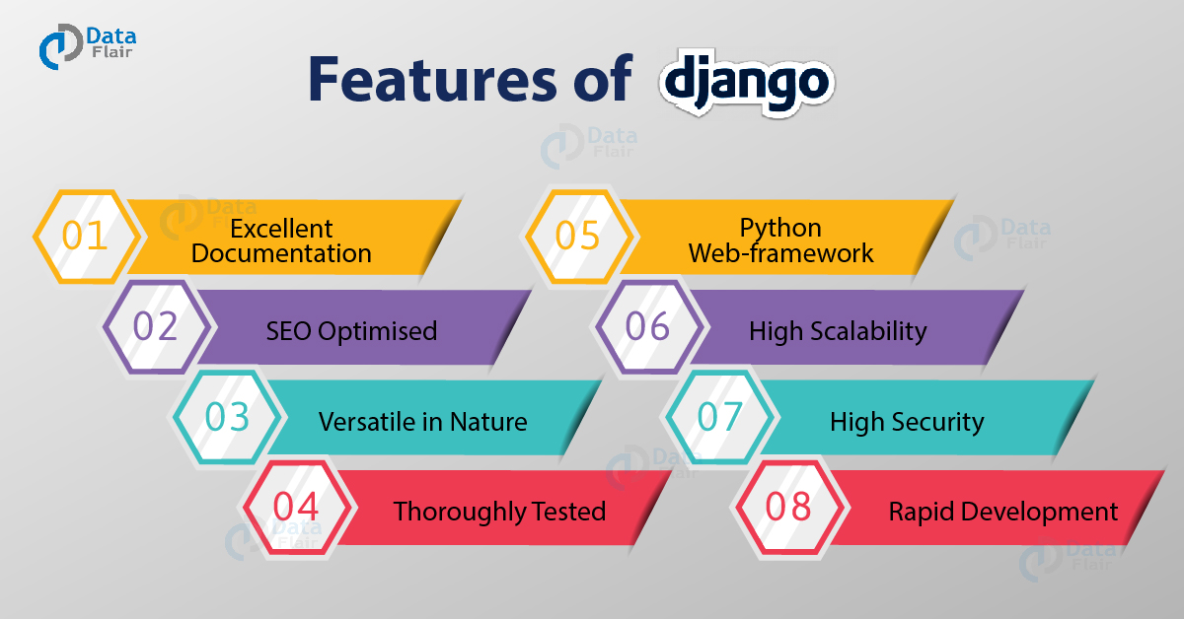
Django
Maintainable -- DRY (Don’t Repeat Yourself)
Portable – can run on many server platform
Reusable - MVC (Model – View – Control)
Administration

Slide 10
MySQL
Relational database
Compared to NoSQL database like Mongodb
Reduce data duplication
Slower queries
Scalability and Flexibility
High Performance
Light-weight

Slide 11
Frontend
APIs
The Movie Database API(TMDB)
The Open Movie Database(OMDB) API
Fenier API (self-design)
CSS & External Libraries
Ant Design
CanvasJS Charts
React-Bootstrap

Slide 12
Backend
RESTful API -- Django REST framework
Movies – GET request
Reviews – GET, POST, PUT, DELETE request
Users– GET, POST, PUT, DELETE request
Models (Tables)
Movies
Reviews
Users

Slide 13
Background
Features
Tech Stacks
Presentation

Slide 14
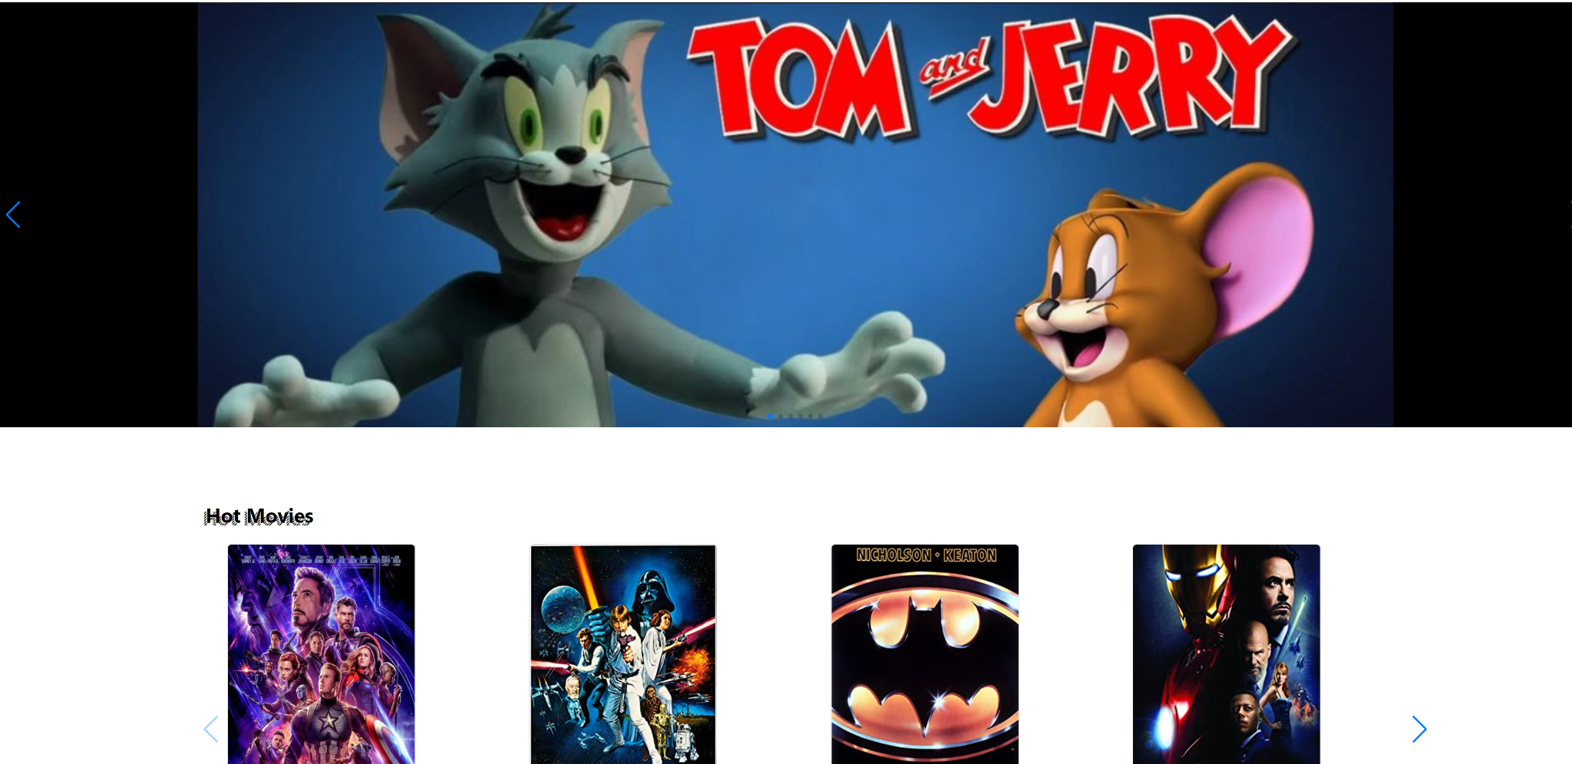
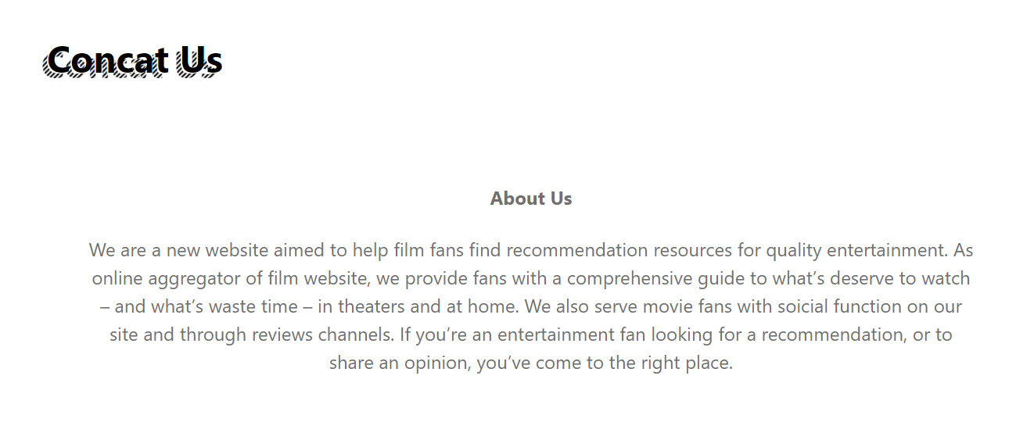
Homepage
Contain the slide which is three of our favorite movies.
Contain hot movie read from database, each page shows max 4 movies.
Contain our basic information.

Slide 15
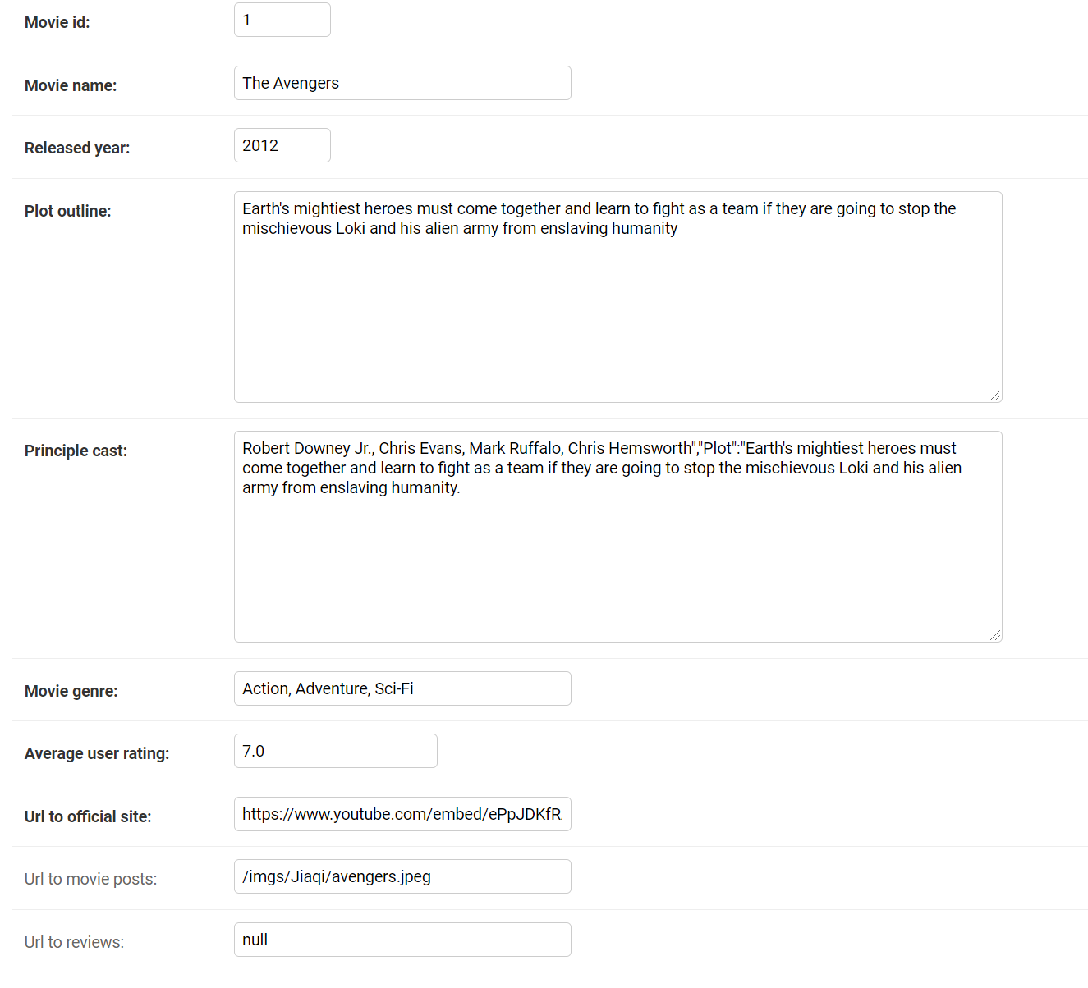
Movie details
The details of the movie include ten parts.
Identify the movie.
Movie name.
Released year.
Plot outline.
Principle cast.
Movie genre.
Average rating.
Movie video link.
Movie image link.
Reviews.

Slide 16
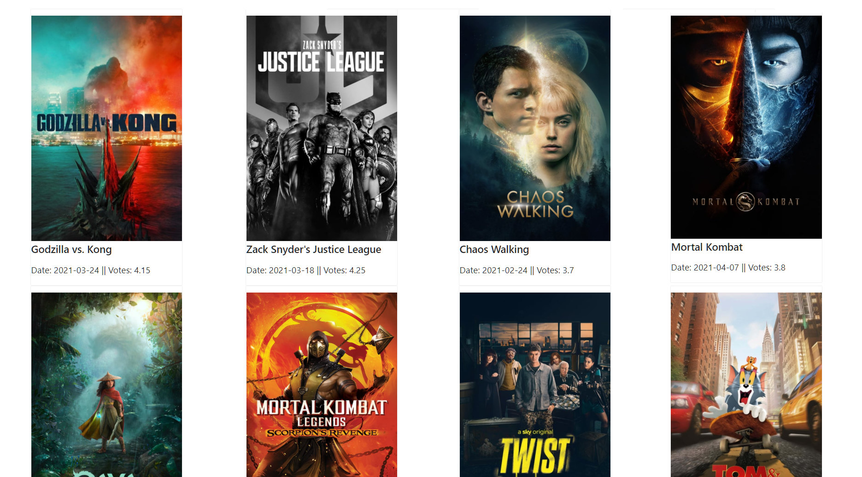
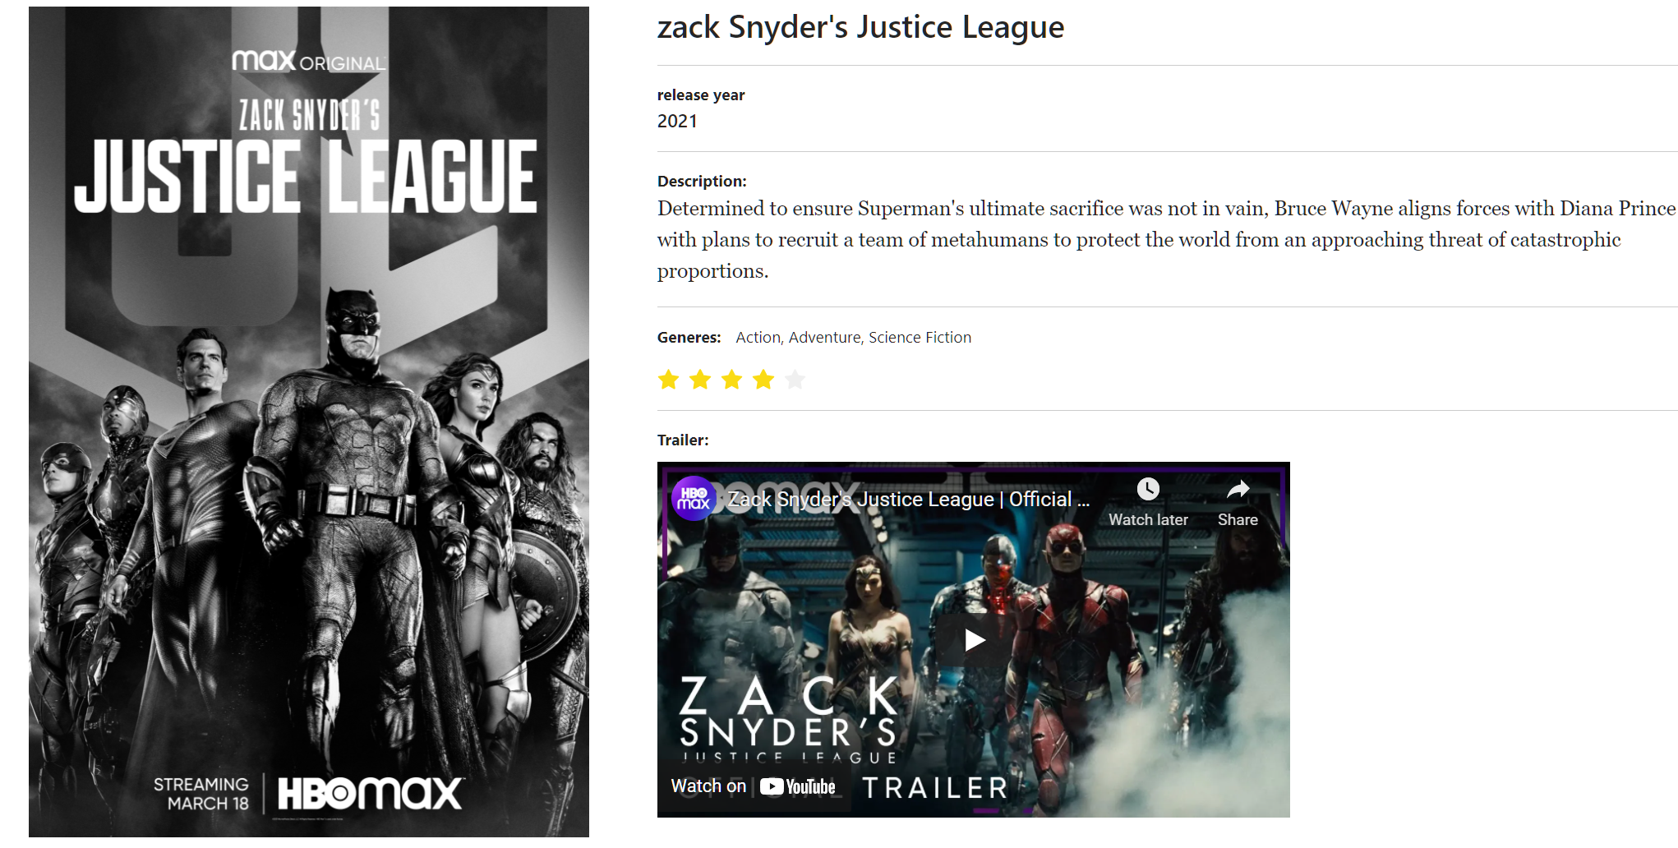
Movie information page and movie list
Used the data from The Movie Database API to retrieve a list of the top movies and render them using the movie list component.
Ant-design as UI design language
View the movie details in a modal when a user clicks on a movie
Components:
CardTemplate
Movie list:
Movie page: List the full movie title, description, Poster, rating, review and the Trailer.

Slide 17
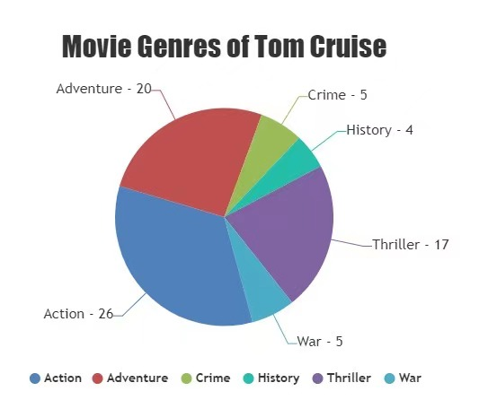
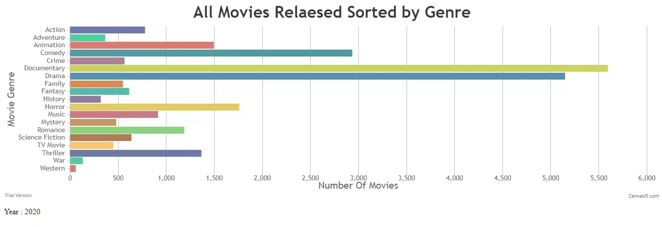
Data Analysis
Canvasjs chart - create bar chart and pie chart

Slide 18
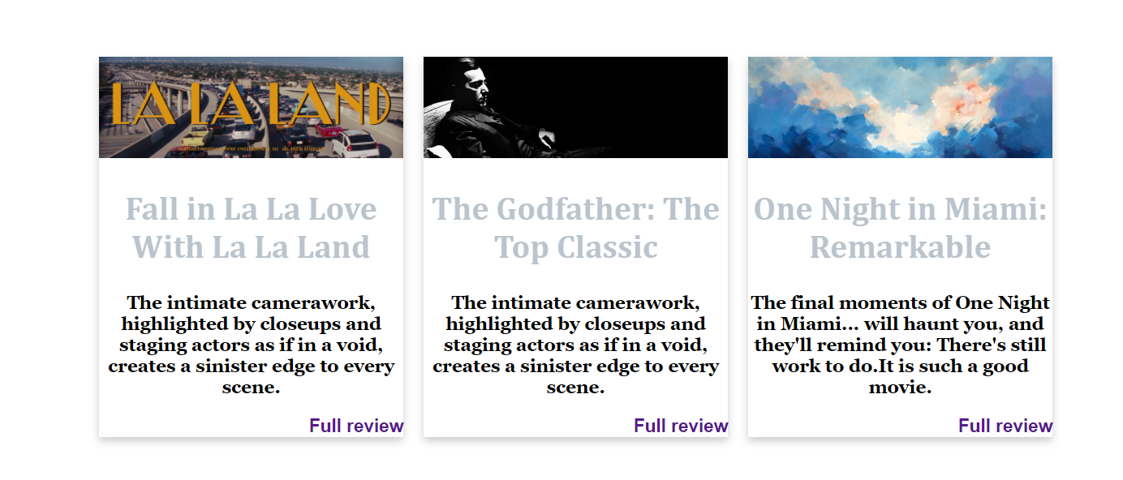
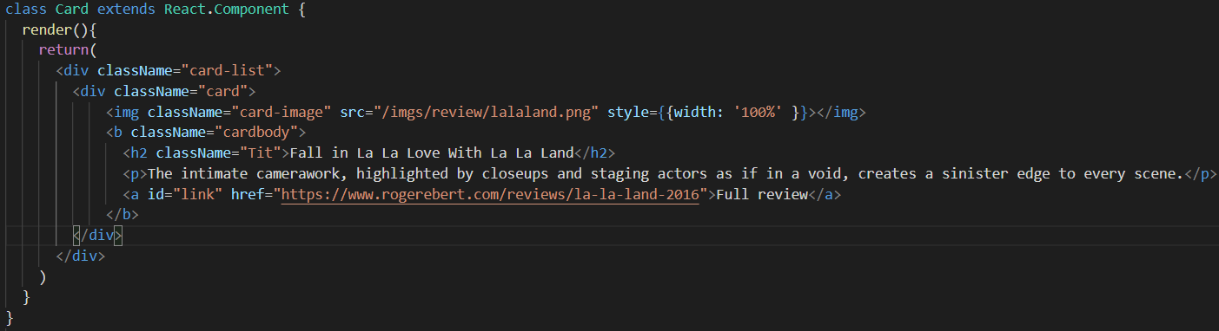
Review Card
Show the popular long reviews of movies
Link with external website

Slide 19
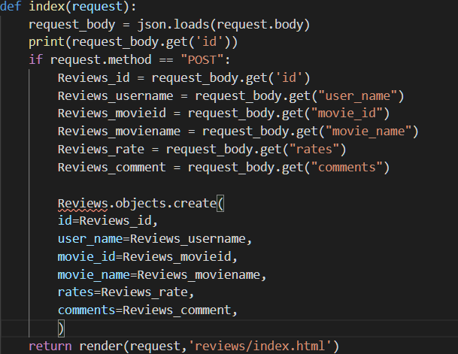
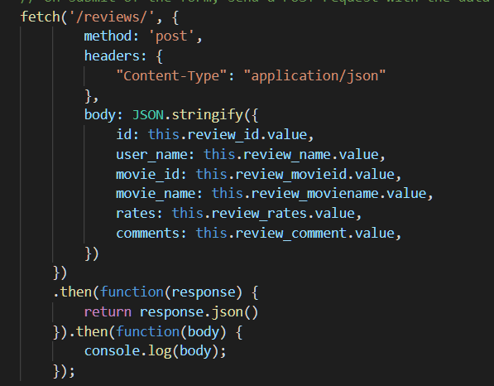
Add Review
Include user name, rates, comments
Using django backend to get data
handleSubmit(), fetch(‘/reviews/’)
Onsubmit of the form, send a POST request with the data to server

Slide 20
In the future
User Login - 0Auth2.0
Booking Ticket Application
Redis cache

Slide 21
Thank You!

